Slide 1


Digital Peer Support:
Ever emerging, not something we can ignore
May 2024

Slide 2

What’s Happening Around the World

Slide 3
The Importance of Digitally Based Support
Accessibility
Online support removes barriers related to physical location, transportation, and scheduling, allowing individuals from diverse backgrounds to access support from the comfort of their own homes.
Anonymity and Privacy
Online platforms provide a level of anonymity and privacy that can be comforting for individuals who may feel hesitant or stigmatized about seeking support in person.
Cultural Responsiveness
Recognizing the importance of integrating technology into services and supports, particularly for young individuals, within the context of their generational norms.

Slide 4
Opportunities in Digital Peer Support
Accessibility to remote areas: Telehealth platforms enable access to individuals in rural and underserved regions, overcoming geographical barriers to support services.
Cost-effective solutions: Implementing telehealth for peer support can reduce costs, making services more affordable and scalable.
Enhanced reach and scalability: Leveraging tele-health expands the reach of peer support programs, allowing for broader participation and engagement across diverse populations.
People have a choice of peer. They are able to match to a peer vs. being assigned a peer.
Increased days/ hours of availability

Slide 5

Servicing Rural Areas
Challenges in Rural Areas
Limited access to mental health resources in rural areas
Stigma around seeking help for mental health issues
Shortage of trained professionals in remote locations
Cost of serving individuals face to face
Solutions for Rural Support
Leveraging technology for virtual support services
Implementing community outreach programs in rural areas
Training local individuals to provide peer support services virtually
Increasing peer support service availability

Slide 6
Cultural Responsiveness in Online Platforms
Importance of
Cultural Responsiveness
Strategies for Inclusivity
Online platforms accommodate diverse cultural backgrounds and identities, fostering understanding and acceptance.
Participants can express themselves in their own language, connecting with similar cultural experiences.
Creating spaces where individuals feel understood and accepted.
Encourage open dialogue about cultural differences to promote understanding and respect.
Variety of technology options for sessions that reflect the seekers cultural preferences for communication.
Train staff on cultural competence and sensitivity to ensure a welcoming and inclusive environment.

Slide 7

by Flourish Labs
Pioneering the use of technology to empower with empathetic, tech-savvy peer support, and boldly tackle mental health challenges head-on
Employing young adults with diverse backgrounds
Building a future of flourishing minds for all: where everyone can be their best self and achieve their potential

Slide 8



Youth Mental Health Support Model
Expanding Workforce
Certifying Specialists
Delivering Support
Hiring and training young adults with diverse backgrounds. Offering support from professional peer supporters to teenagers and young adults.
Certifying Peer Support Specialists with lived experience of mental health, substance use challenges. Recruiting nationally for a diverse workforce, matching peers based on experience and diversity.
Delivering culturally responsive support from certified Peer Support Specialists. Improving accessibility and quality of care through technology.

Slide 9



Cultural Responsiveness
Diversity Initiatives
Community Outreach
Current Diversity Statistics
Promoting diversity through inclusive hiring and retention strategies. Enhancing cultural awareness and support within the organization. Providing avenues for peers to voice their concerns and ideas for improvement and be directly involved in implementing those improvements.
Our workforce statistics reflect of the peer supporters with peers.net:
55% identify as BIPOC
58% identify as LGBTQIA+
13% identify as trans individuals
Engaging with diverse communities to source talent and create an inclusive work environment.

Slide 10

How do Youth & Young Adults Find Us
How youth find us
Highest Search Terms
Mental Health quizzes/ test
Seeking Diagnosis
Free Therapy
Free Anonymous Chat
Mental Health Apps
Do I have…. Depression, Anxiety, Eating Disorder etc.
Referral Partnerships
Online Searches
Co Marketing partnerships
Social Media
Live peer support chat

Slide 11
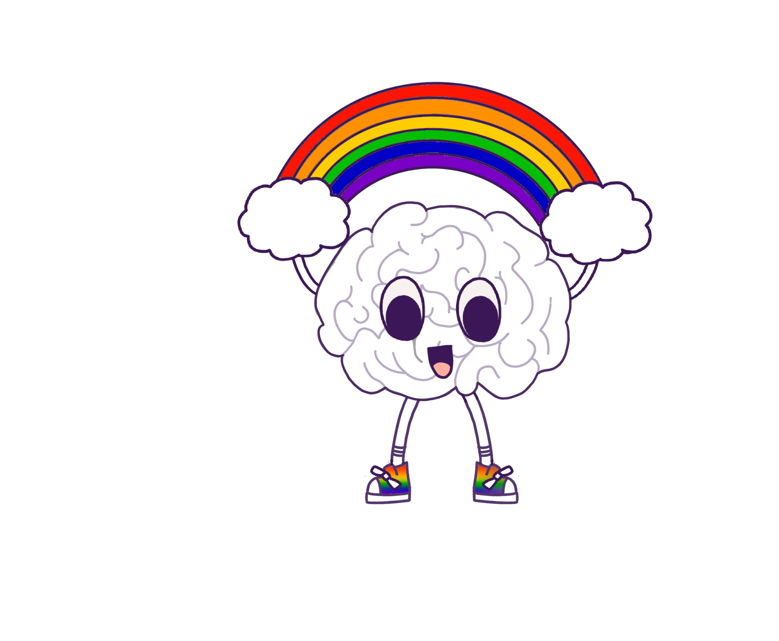
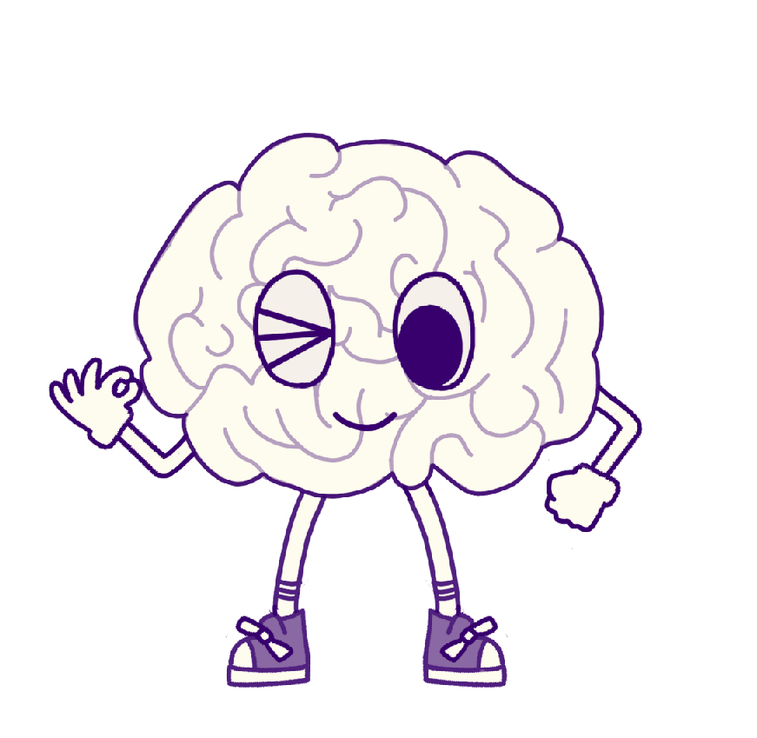
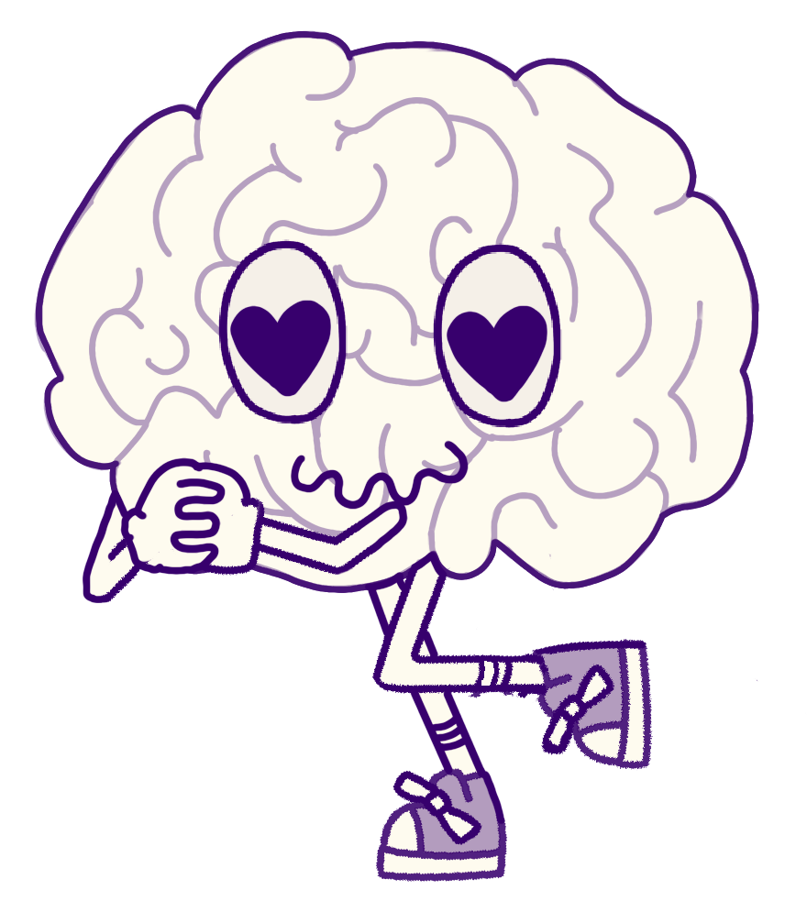
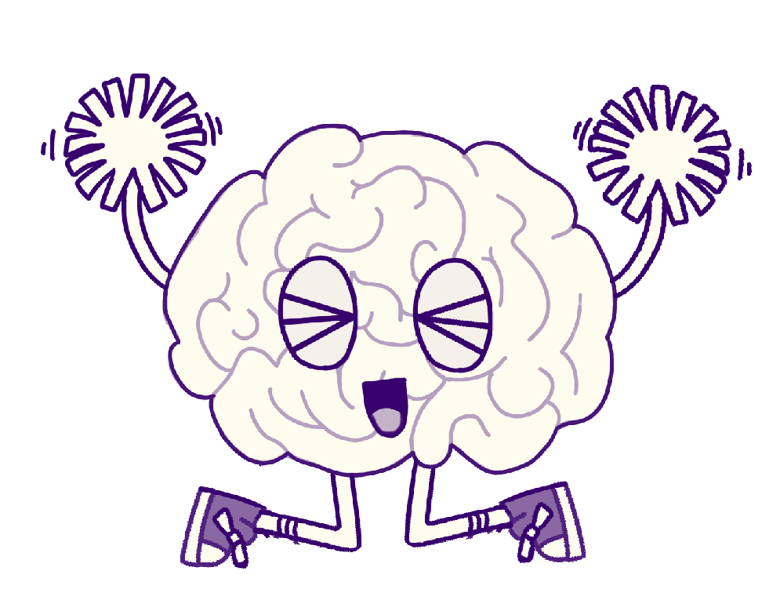
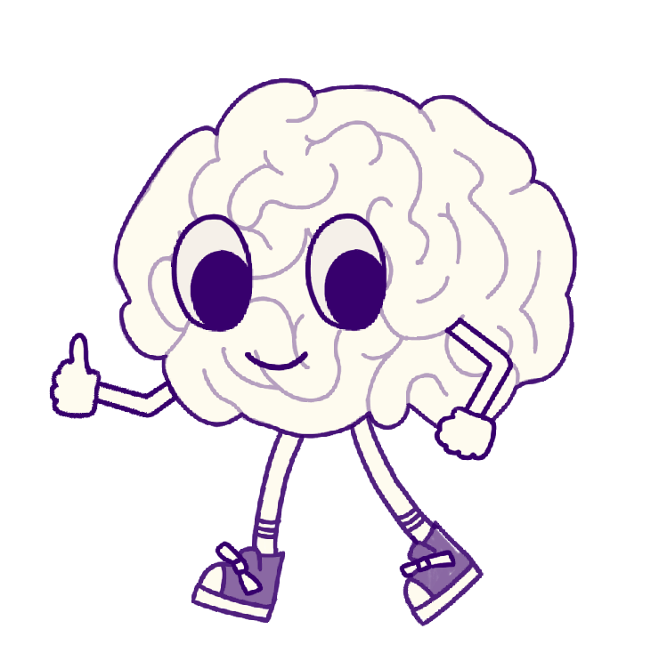
What do our Seekers Have to Say?
“I'm very glad that there's people out there willing to listen and try understand some scenarios, in my circle I feel like I cannot speak to anybody about this stuff, I feel so much more relieved now, thank you for listening to me, It means a lot”
“Thank you. I have to go now but I’m so deeply thankful for this experience. Thank you so much for listening to me and validating my thoughts”
.
“I feel a lot more relieved just having someone listen to me and my problems. Again, thank you so much. You're truly an angel.”
“This is a tmi, but I'm glad chats like these exist since I don't have any close friends or family 👍 thank you!!!”
“im about to sleep thank you again for listening it really helps”
“thank you so much for guiding me through making the decision, I feel a lot less worried now!”

Slide 12
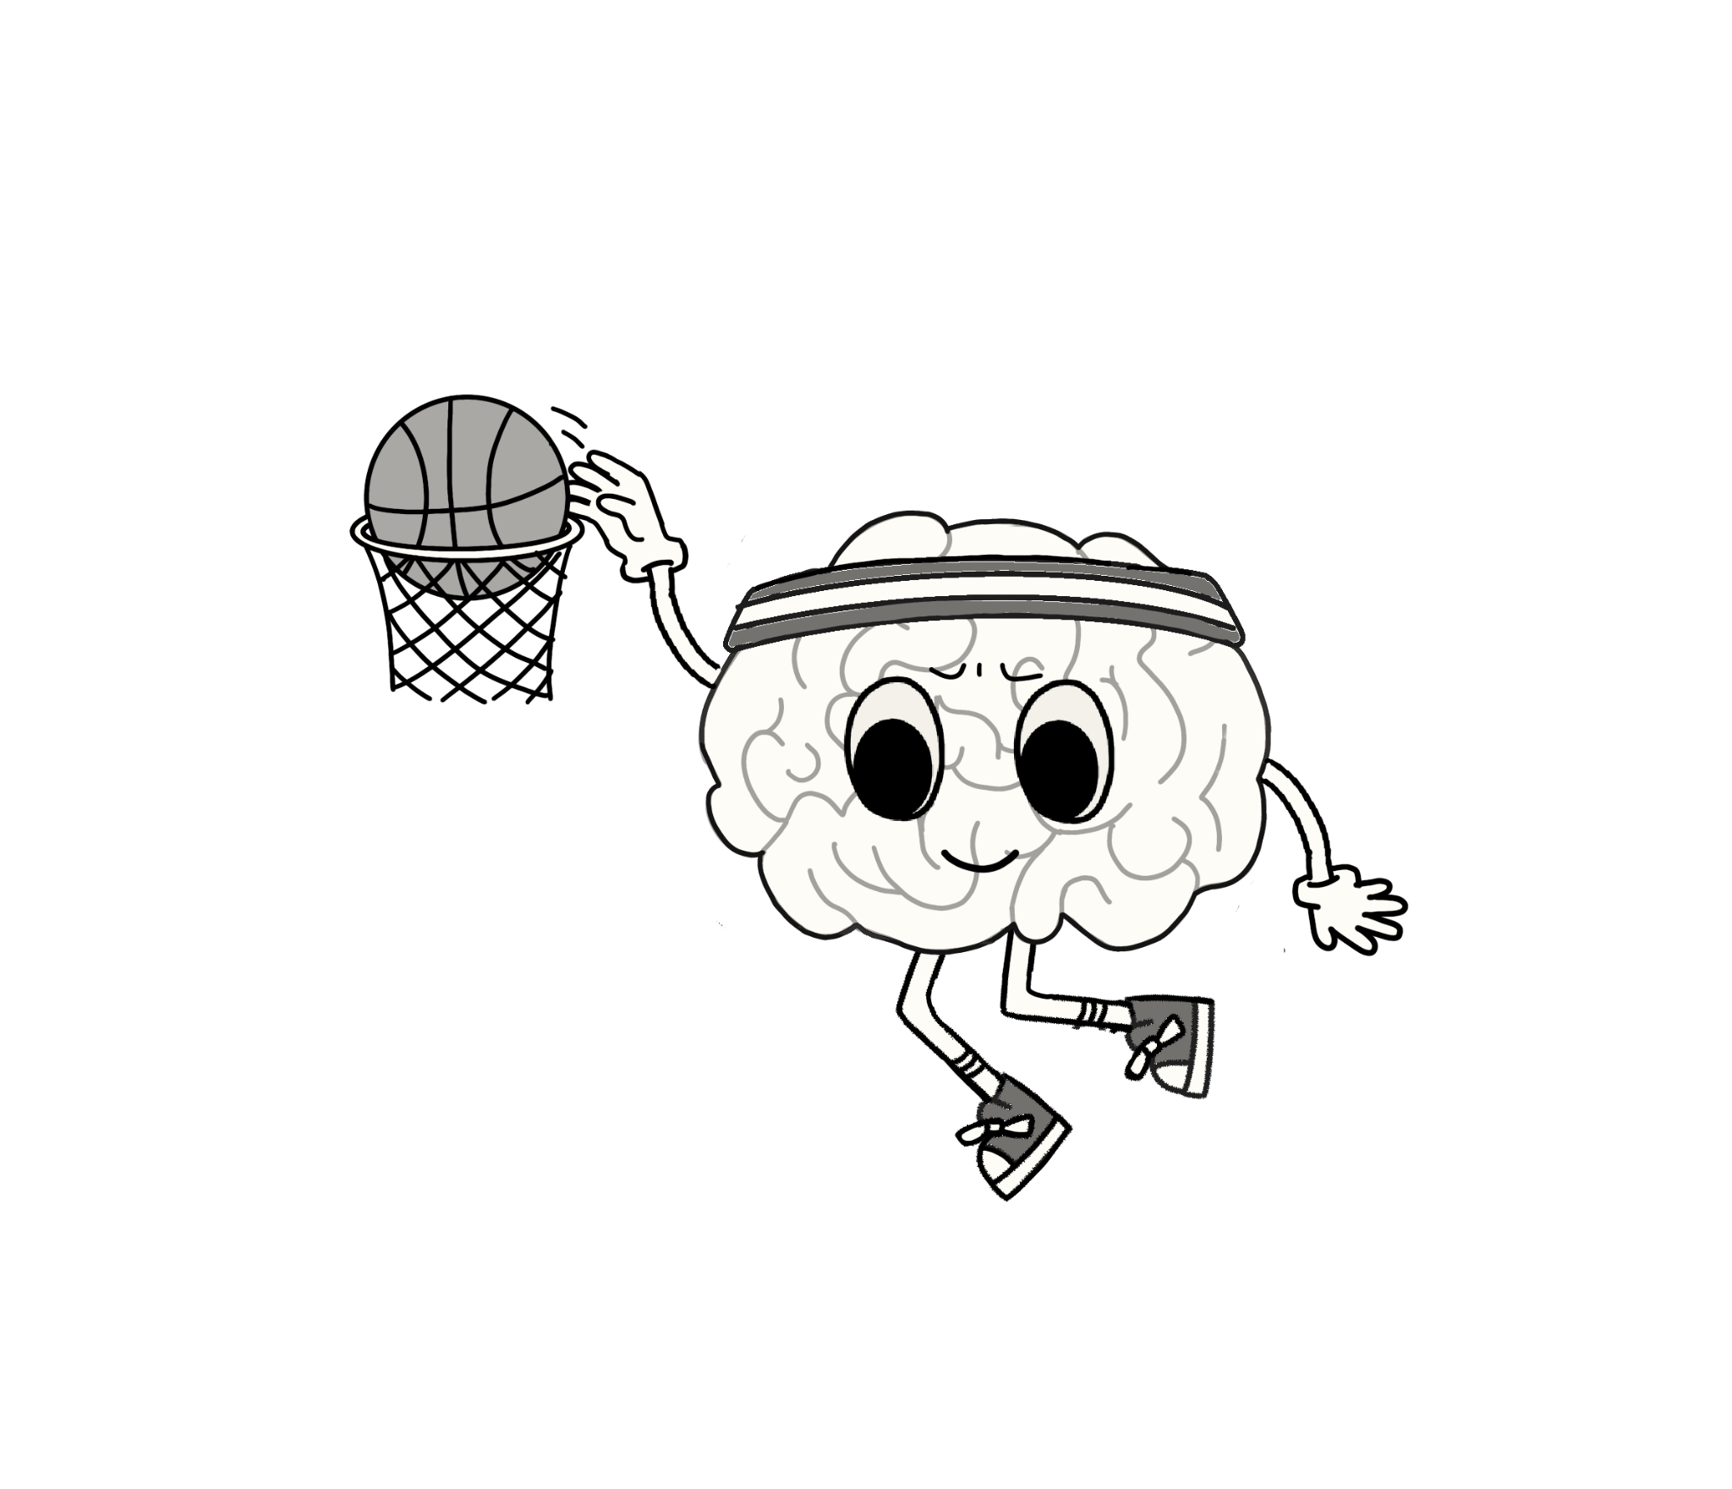
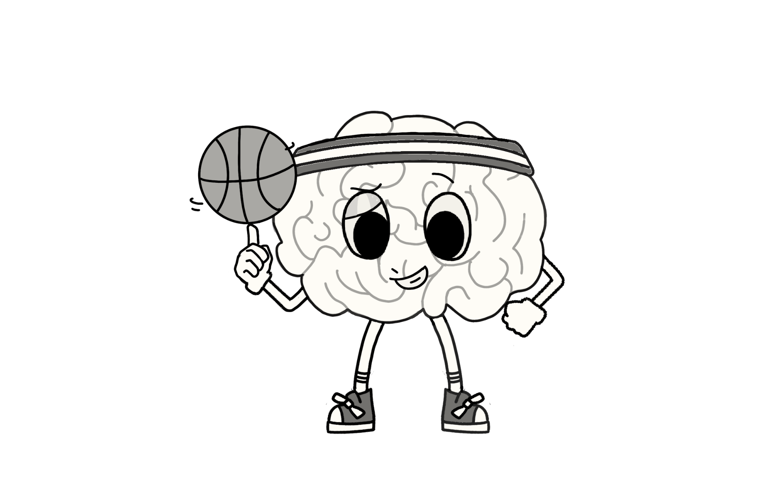
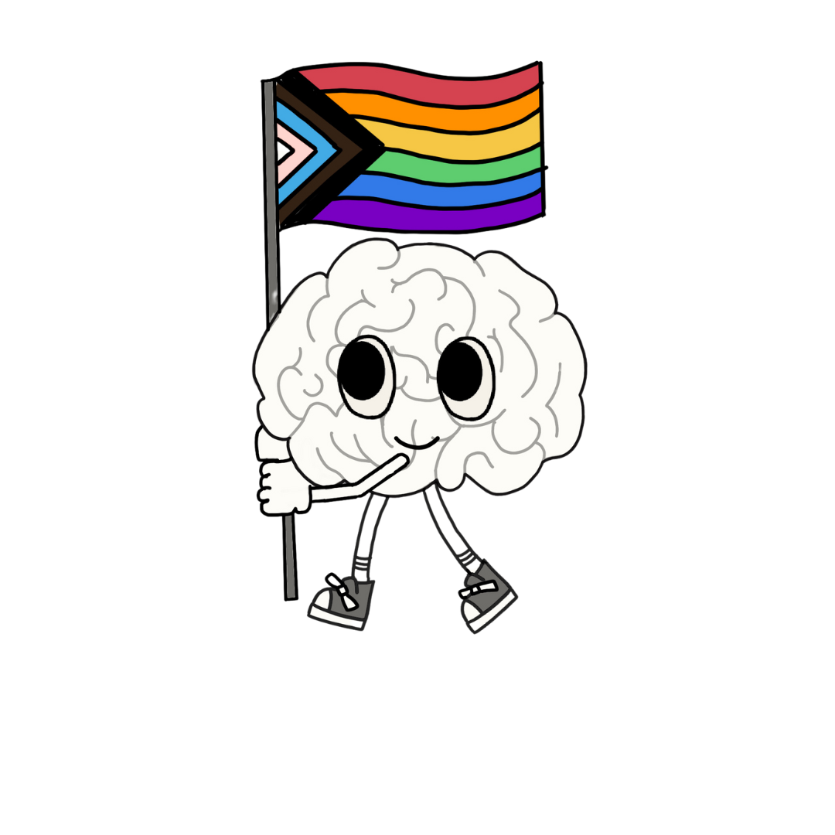
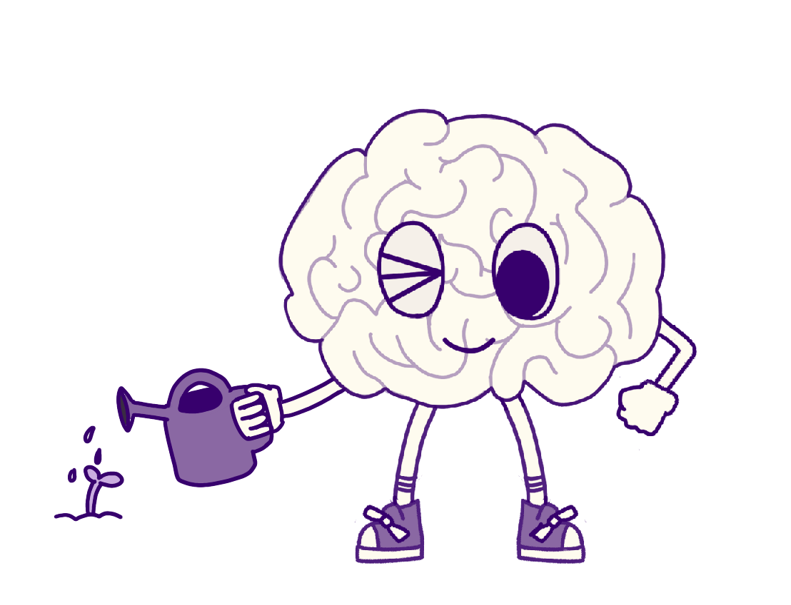

What do our Seekers Have to Say?
“Thank you so much for this it truly changed the way i view this now and will help me get through this as well. talking to you helped take some weight off my chest thank you for listening to me 🪷💕”
“thank you a lot just for being there and letting me vent, it's so nice to be understood”
“yeah thank you so much for listening to me until now I had only my bf to listen and I hated putting that verdant on him so I truly thank you”
“Thank you for your support, its so helpful to know i’m not being judged or analyzed and that you understand me. “
“That really meant a lot to me. Thank you for sharing that coping skill. I will try it out. I love to write lol. I hope you have good rest of your night!”
“I feel so much better now, that coping we did took away my panic attack. I don’t know what I would have done without you!”

Slide 13

Enhancing Peer Support Services
Online platforms enable real-time interactions, resource sharing, and extended support hours, enhancing the overall peer support experience.
Some places are incorporating AI for documentation review, record audits, pinging supervisors to review concerning topics.
Never use bots to interact with seekers, ensuring real people are there to form meaningful connections.

Slide 14
Challenges in Digital Peer Support
People outside of peer support and mental health don’t know what peer support is
People, especially young people, are trying to gain emotional literacy by googling and social media
People don’t have easy access to insurance or ability to pay if its not funded
Connectivity issues in remote areas can hinder access to digital services and peer support.
Language matters! Ex; Changing terminology from “sessions” to “chat”

Slide 15

Creating Accessible Programs
Web-based platforms to offer on-the-go support for individuals with varying schedules and needs.
Additional tools for on demand chat
Implementing secure and user-friendly interfaces to ensure privacy and ease of use for all participants.
Integrating video conferencing/Chat/Voice and multimedia tools to enhance engagement and connection.

Slide 16

www.robynpriest.com www.explorationmastery.com robyn@robynpriest.com
Thank You

